Slide 1




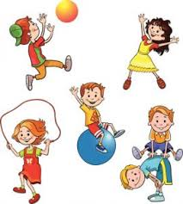
EYFS Newsletter
Autumn 2—2024/2025
Notices and Reminders
Don't forget to upload any achievements onto Tapestry.
Please upload any celebrations you have experienced as a family for us to share in circle times.
Please speak to a member of the nursery team if you are unable to access Tapestry.
Key dates
November
Tuesday 12th- Odd Socks Day for Anti-Bullying Week
Wednesday 13th- Nursery Boogie Mites workshop
Friday 15^{th-} -Children in Need – Crazy hair & Spots day
Monday 18th – Thursday 21st Scholastic Bookfair
December
Tuesday 3rd - SEND Coffee Morning
Wednesday 11th - Elf Run for Phyllis Tuckwell
Friday 13th - Christmas Jumper Day
Wednesday 18th – Nursery Christmas Show
Wednesday 18th - Nursery Christmas Party
Wednesday 18th - Carols on the Playground- 5pm
Friday 20th - End of Term
January
Monday 6th - Return to School
Friday 17th - Inset Day
Communication and Language
We will be supporting your child's understanding of questions and how to answer these. To widen their vocabulary and continue developing listening and attention our circle times will be based on high quality texts and themes. This term our theme is My Colourful World. Children will share their family celebrations such as birthdays, Christmas and Diwali. Adults will act as play partners during child led learning, modelling language and asking questions.
Physical Development
This half term there will be a priority on developing the children’s fundamental movement skills, which include balancing, running, changing direction, jumping, hopping and travelling. Children will develop gross motor skills through a range of activities. They will continue to develop their fine motor skills with one handed tools and equipment and to begin to develop their pencil grip.
Personal, Social and Emotional Development
The children have settled well into their new environment and are beginning to form positive relationships with staff and other children. The children will continue explore our emotions and self-regulation. As the children continue to strengthen friendships, they will be supported in managing turn taking and sharing resources. They will continue to embed expected behaviours and consistent routines.

Slide 2
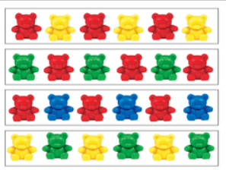
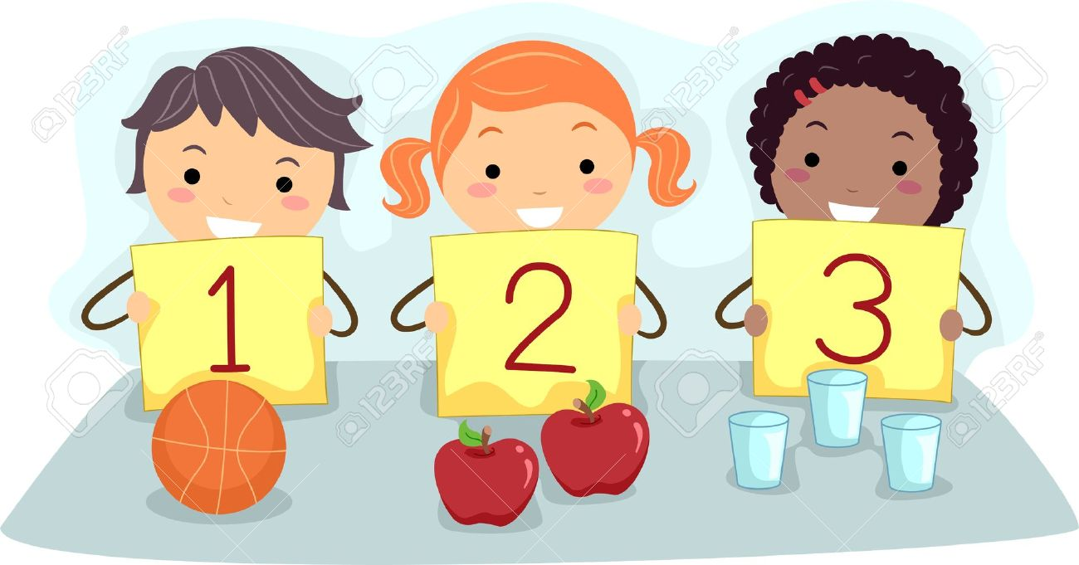



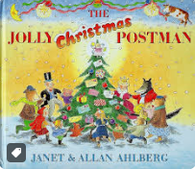


Literacy
The core books explore our colourful world. The children will be joining in with repeated phrases, answering questions about the story and recalling main events. The children's understanding will be developed through story maps and drama. They will be learning new vocabulary through our play and enjoying lots of stories and rhymes together. The children will be developing their book handing skills and beginning to understand that print conveys meaning. They will enjoy drawing freely and begin to make meaning to the marks we make. They will continue developing our early phonics skills through Phase 1 Letters and Sounds.
Mathematics
The children will continue to practise sorting and classifying of objects by size and colour and then start to use this knowledge to follow a simple repeating pattern. The children will also be learning to count out small groups of objects, making sure they say one number name for each item in order. Children will know that the last number reached tells you the total in the set (cardinal principle).
Understanding the World
Our theme explores families and celebrations. The children will be sharing family experiences both past and present. They will know about family celebrations and events celebrated by different groups of people. Their pretend play will imitate everyday actions and events from their own family and cultural background. They will continue their exploration of seasons and how the weather and environment changes as we approach winter. The children will continue to use hands on experiences, use their senses to talk about the differences and changes they notice.
Expressive Arts and Design
The children will continue to develop their understanding of colour mixing through paint activities. They will learn how to include details on their drawings as well as how to create closed shapes with lines. Through our topic, the children will have opportunities to develop their imagination further, with pretend play and multi-sensory expression. As Christmas approaches, they will learn new songs and share their likes and dislikes about different pieces of music.
How to help at home
Go on a Winter Walk and play 'I Spy' or 'I Hear', notice patterns, compare to autumn, collect objects and compare them.
Notice familiar signs and logos. Notice that print has meaning.
Talk about what happens during the Winter months e.g., Christmas/New Year. What celebrations do you celebrate as a family?
Talk about what animals do in the Winter months? What animals live in cold places?
Sing Winter themed songs e.g., 5 Little Snowmen and I'm a Little Snowman.
Suggested books for reading

