Slide 1


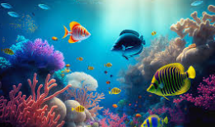




Nursery Newsletter
Summer 2—2024/2025
Notices and Reminders
Please remember to continue to add photos and videos to Tapestry. This can be anything from key events, celebrations or milestones in your child’s life.
Don’t forget to complete the form for our Grandparent’s Gardening Day. Please click the link below:
https://forms.office.com/e/FXbKYVB6ZL
Key dates
May
26th – 30th May- Half Term
June
6th June- Inset Day
18th June – Grandparent’s Gardening Day
28th June- Summer Fayre
July
2nd July- Nursery leavers trip to The Lookout
Nursery closed
22nd July- End of term (finish at 1.30pm)
September
3rd September- Inset Day
4th September- Inset Day
5th September- Start of Term
Communication and Language
Through our under the sea topic, the children will be continuing to learn and explore new and exciting language. They will focus on asking and answering questions using why and how. The children will develop their concentration and attention through exploring seaside objects and animals. They will develop their imaginary and pretend play skills. The children will learn prepositions using in, on, under and behind.
Physical Development
This half term, the children will be developing their pencil grips and learning to apply their phonics knowledge to write recognisable letter shapes. They will also explore patterns, such as zig zags and curves, as well as forming complete 2D shapes, such as circles and squares. They will continue to use their name cards to copy letter shapes in their name as well as trying to write their name independently. The children will have opportunities to develop their gross motor skills, focusing on bat and ball skills.
Personal, Social and Emotional Development
This half term, the children will be learning how to be a good friend. They will be supported in taking turns, sharing and being sensitive towards others' feelings. The children will be learning about the importance of oral hygiene. They will be talking about their teeth brushing routines and learning why it is important to brush their teeth twice a day.

Slide 2
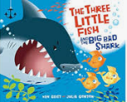




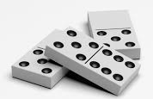

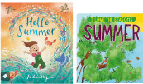

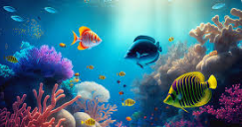
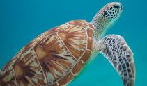



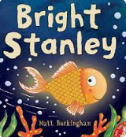
Literacy
This half term, the children will continue to develop early literacy skills through the core texts 'The Rainbow Fish’, ‘The Three Little Fish and the Big Bad Shark’, ‘Tiddler’ and 'Super Duper You'. They will use new vocabulary to develop storytelling through play. Through early phonics sessions, they will increase their awareness of words that rhyme and learn to produce rhyming words. The older children will continue to explore phonemes (sounds) and learn how these phonemes are linked to graphemes (letters).
Mathematics
In our final half term, the children will be consolidating lots of the learning from throughout the year. They will revisit 2D and 3D shapes, copy and follow simple patterns, count out groups of objects and find the matching numerals. They will be thinking about number order and using the words before and after. When thinking about the composition of number, they will sort dominoes by how many spots are shown and will also explore the different ways that 3, 4 or 5 items can be shared between two people.
Understanding the World
The children will be exploring their natural world through their core books and learn about sea animals and their natural environment. Their non-fiction texts will help the children revisit previous learning about caring and respecting our natural world and link this to developing their understanding of different features and countries. The children will develop their understanding of different animals and sorting them into their environment, such as land and sea. The children will explore the season summer and begin to describe differences in weather.
Expressive Arts and Design
The children will explore sea creatures, learning to use their imagination to draw them. They will practice simple drawing techniques, learning how to include more detail in their pictures. They will have the opportunity to explore different materials and media to develop their ideas, as well as building models to represent sea creatures. The children will be encouraged to develop their pretend play further and extend this among a larger group.
Homework
Talk to a grown-up about how to stay safe around water.
Explore floating and sinking at bath time.
Please upload photos or videos of your experiences visiting the seaside or an aquarium for us to share with the children via Tapestry.
Can you make a model of a seaside creature using cardboard boxes, tubes and plastic containers?
Tell an adult about your favourite sea creature. Can you draw a picture? What colours would you use?
Suggested books for reading

